Slide 1
investor vs Ta vs Trader
Pukar Sharma

Slide 2
Overview
Investor and Investment and its intuition
Technical analyst vs Trader
Basic Concepts of Trading
How traders should start

Slide 3
Investor and Investment and its intuition
Investor: Long-term focus, seeks to build wealth gradually through asset appreciation and dividends.
Investment: Hold assets over time, benefiting from market growth and compounding returns.
Intuition: Investors analyse fundamental value; traders rely on technical analysis and market trends.

Slide 4
Does Technical analyst and trader are same ?
Technical analyst
TRADER
Focus: Analyses historical price and volume data to predict future market movements.
Tools: Uses charts, indicators, and patterns to identify trends and potential entry/exit points.
Role: Provides insights and recommendations based on technical analysis but may not execute trades themselves.
Focus: Buys and sells financial instruments to make a profit.
Tools: May use technical analysis, but also relies on market news, sentiment, and other strategies.
Role: Actively executes trades based on various analysis methods, including technical analysis.

Slide 5
Traders vs technical analyst vs investor
Traders
Technical Analyst
Investor
Who are they ?
What's their beliefs
Goal
Who are they ?
What’s their beliefs
Goal
Who are they ?
What’s their beliefs
Goal
Home work

Slide 6
What is trading ?
Trading is a reactive action based on a combination of diverse strategies.
We are under the circle of control.
We need a proper trade management system that includes diverse strategies such as psychological balancing, risk management, and strategic analysis.

Slide 7
Who are bad technical analyst ?
Those TA who try to predict/forecast the market with less homework, have an undeveloped mindset, and attempt to teach others are bad technical analysts.
They are Bad Trader because they claims market movements and give tips to others, but there is no any study that can predict the future.
They always try to estimate tops and bottoms; predict future due to the Bandwagon bias (FOMO)
They try to control the circle of concern

Slide 8
Circle of concern and control
Concern:
Market movement
External events
Economy
Covid
Control:
Their actions
Trading Strategy
Risk management
Traders focus on this part
Bad TA focus on this part

Slide 9
The trader journey start
Beginners Psychology vs Fundamental Truth
Belief system
Developing Traders Mindset
Component of Trading plan
Phases of Traders

Slide 10
Why ?
Why do you want to trade ?
What do you want in life ? (Moneywise)
What type of life do you want ?
What type of people do you want to be around?
What type of person do you wan to be ?
Where you want to be in 1 year, or 5 years?

Slide 11
Belief system of trader
How you view money
How you view yourself
How you view mistakes
A belief system is a mental representation of how somethings works or what somethings means, based on our personal experiences and interpretations.

Slide 12
Self limiting beliefs are:
Money is evil
Rich people are greedy or dishonest
Money doesn’t grow on trees
I don’t deserve money or success

Slide 13
Fundamental truth of market
Anything can happen.
You don’t need to know what is going to happen next in order to make money.
There is a random distribution between wins and loses for any given set of variables that define and edges.
An edges is nothing more than an indication of higher probabilities of one things happening over another.
Every moment in the market is unique, we cannot forecast with absolute accuracy.

Slide 14
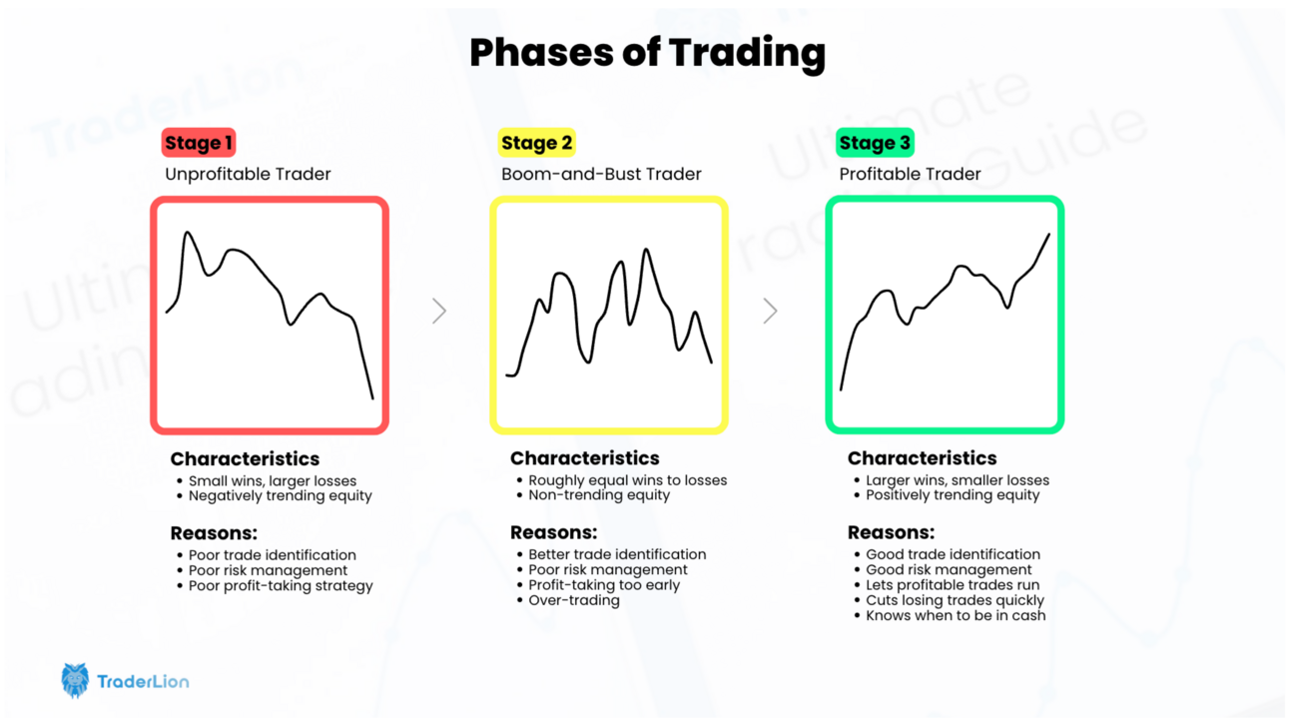

Slide 15

THANK YOU
Pukar Sharma
sharmapukar98@gmail.com

